Slide 1
Discover the Latest GitHub Copilot Features for .NET Developers in Visual Studio
Rhea Patel

Slide 2
Agenda
01
02
Guided Chat
Quality improvements
Function Calling
Related Files and solution traits context
Multi-Model capabilities
Mention detection
Prompt Library
Conversational AI
03
04
Integrated AI experiences
Copilot Edits
Multi files edits
Copilot plans
Fix with Copilot
Set Breakpoints with Copilot

Slide 3
GitHub Copilot features
Visual Studio 2022 17.12
Coming soon…
Code referencing & Content Exclusion for submodules and nested repositories
Guided chat, Prompt Library, Ice breakers
Repo-level custom instructions
Model selection in chat tool window
Related files and solution based traits
Function calling
Visual Studio 2022 17.13
Slash command expansion
Copilot Edits

Slide 4

Sign in to GitHub
Get GitHub Copilot aka.ms/getGitHubCopilot

Slide 5
Upcoming Visual Studio Sessions
Nov 13
6:30 – 7:00 PM PST
​
Master Visual Studio Debugging: Tips, Tricks, and AI Insights!
Harshada Hole
​

Slide 6
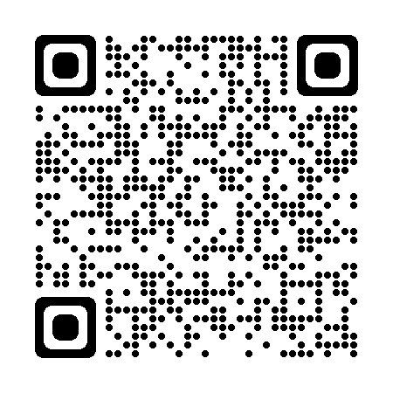
Tell us your feedback!
Help us to make even more community-driven improvements! ​
​
Start the conversation on Developer Community

Slide 7
Thank you

Slide 8
Get .NET 9
Download .NET 9 aka.ms/get-dotnet-9

Slide 9
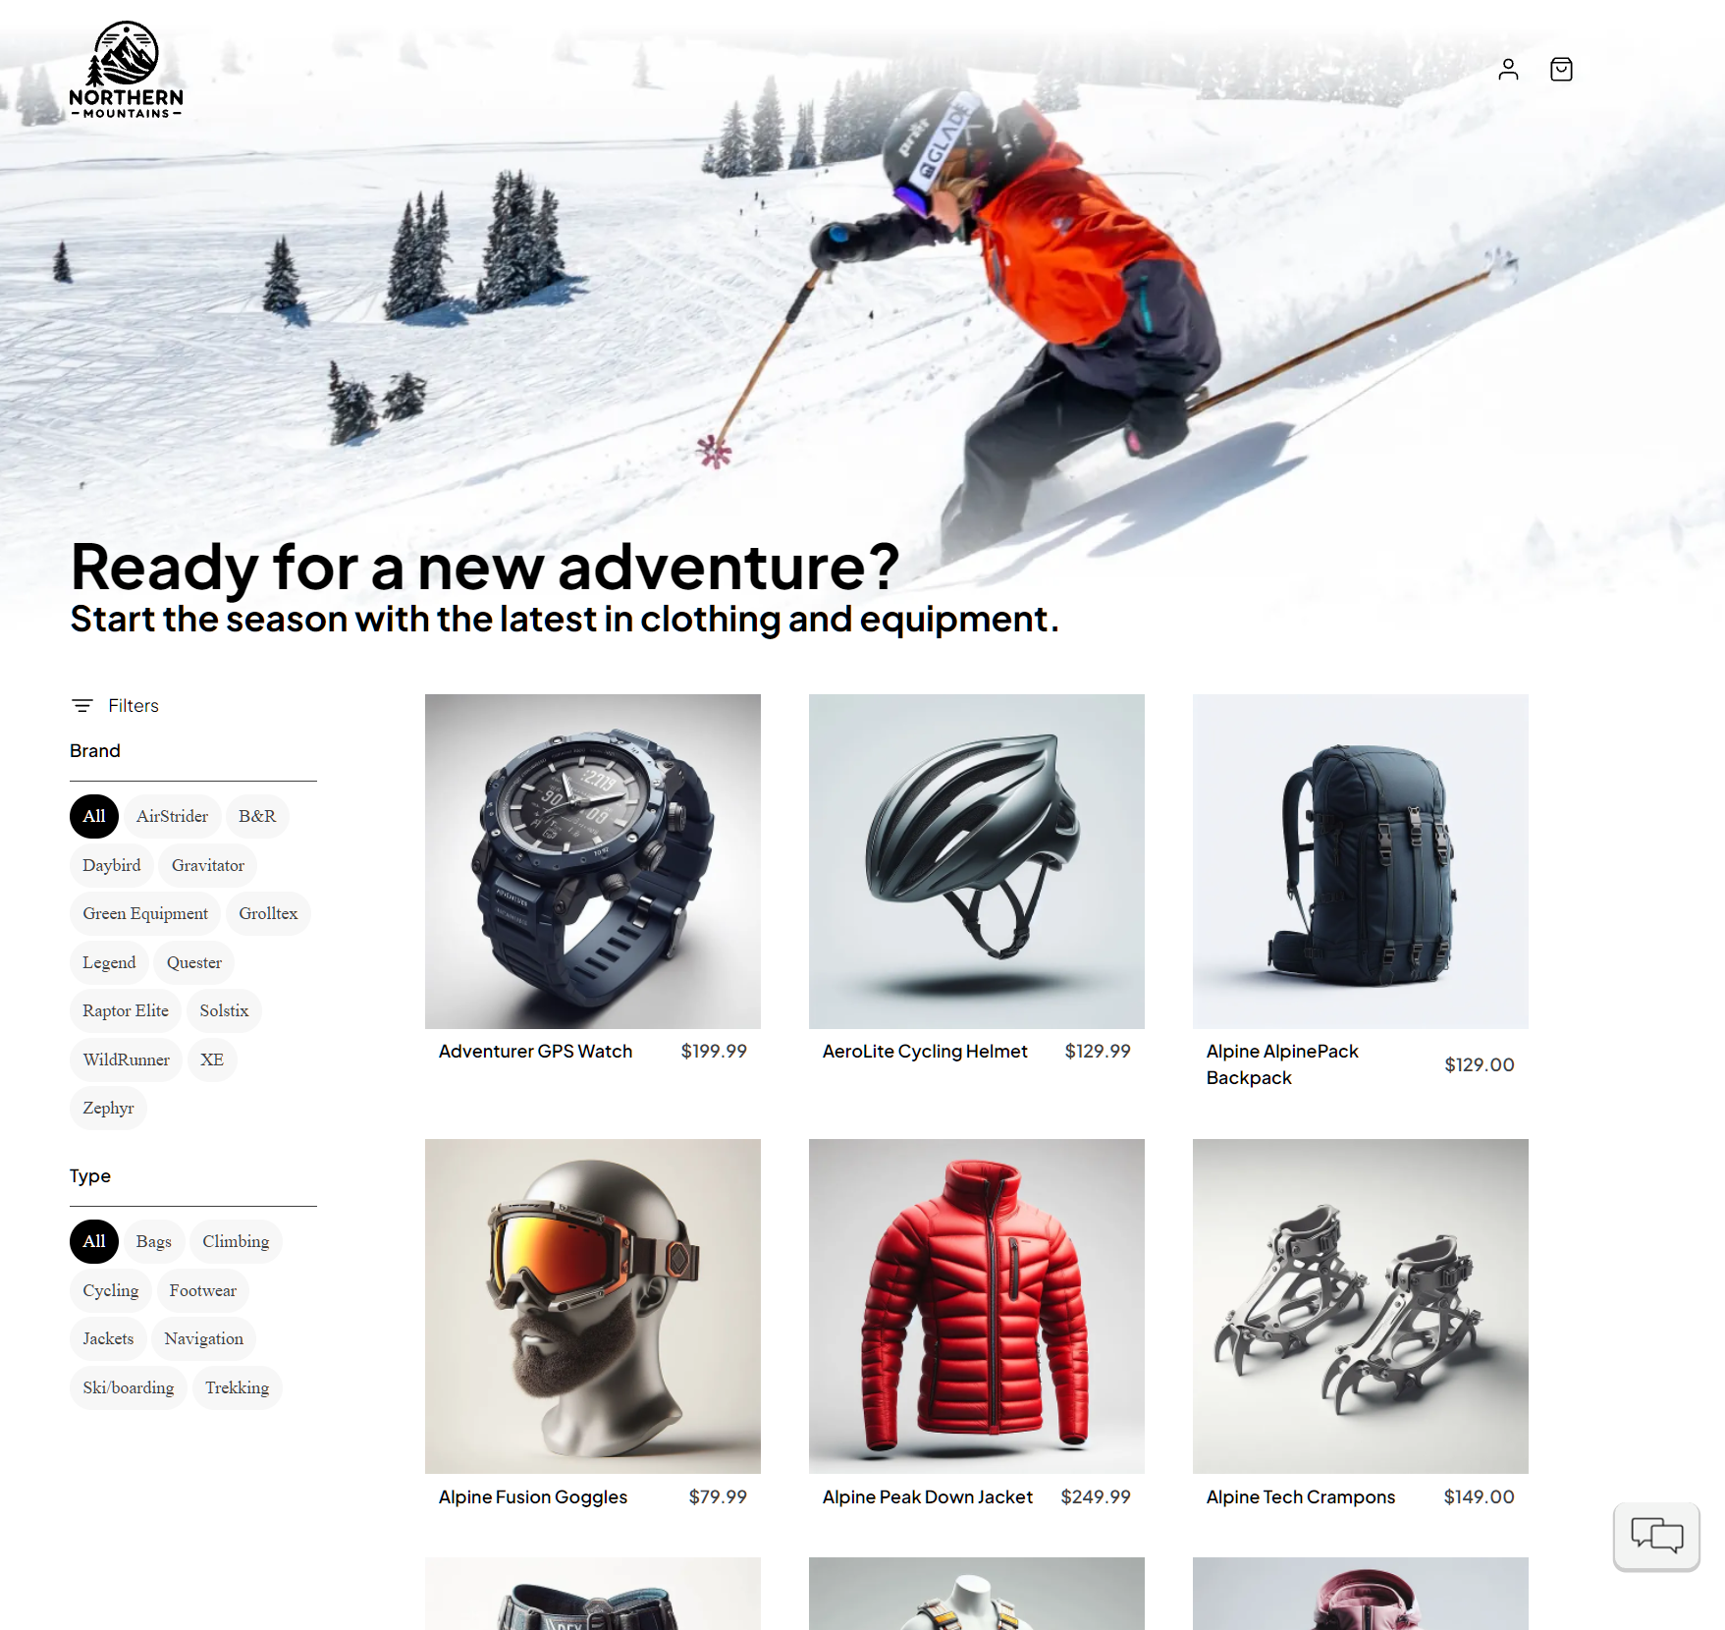
eShop
Framework: .NET 9, ASP.NET Core
Data Layer: Entity Framework Core, SQL Server
DevOps & Cloud: Docker, Kubernetes, Azure DevOps
Solution Structure Architecture:
Frontend: Web and mobile clients built with ASP.NET Core and Blazor
Backend: Multiple microservices managing different functionalities (Catalog, Ordering, Basket, etc.)

Slide 14

Ensure slide content is accessible
CONTRAST
Use high contrast colors for maximum readability.
The recommended contrast ratio is at least 4.5:1.
SHAPE AND COLOR
Use different shapes with a legend to indicate statuses to accommodate for color blindness.
Example:
ALT TEXT
Alt text helps people with screen readers understand the content of slides.
You should create alternative text for shapes, pictures, charts, tables, SmartArt graphics, or other objects.
Here’s how:
Right click on item.
Select Edit Alt Text.
Enter a Description.
If an object is meant to add visual styling and doesn’t contain meaning (e.g., stylistic borders), do not add alt text and instead check “Mark as decorative.”
SLIDE LAYOUTS
Using a built-in slide layout that matches your content ensures a hierarchical reading order of text blocks.
Example:
If a new slide will have a title, rather than starting with a blank layout and adding a text block for the title, choose one of the built-in layouts with a title placeholder.
READING ORDER
Screen readers describe content on the screen in the order it was created.
To ensure your content is read back in the order you prefer, arrange your objects in the Selection Pane appropriately. Objects on the bottom of the selection pane are read first.
Here’s how:
Click the Home tab.
In the Drawing group, select the Arrange drop-down menu.
Click Selection Pane…
Subject 1
Color Contrast Analyzer
Download this tool to determine the legibility of text and the contrast of visual elements.
Subject 2
Subject 3
Download
C1
C2
C3
ADDITIONAL TIPS
Be sure to run the Accessibility Checker! Go to File click the Check for Issues drop down menu click Check Accessibility.
Videos need to be accessible: If your presentation includes a video, ensure it is captioned and audio described (if appropriate).
Visit the Office Accessibility Center to learn more about accessibility in PowerPoint.

